Slide 1
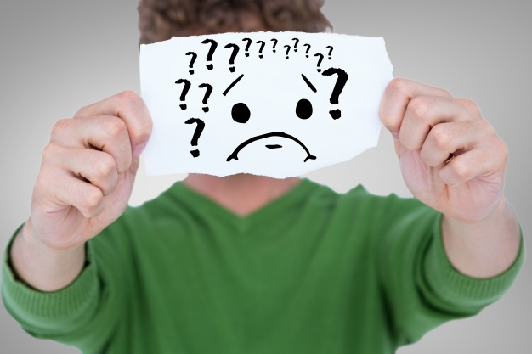
If Grandpa is Sick and not Waking Up

Slide 2
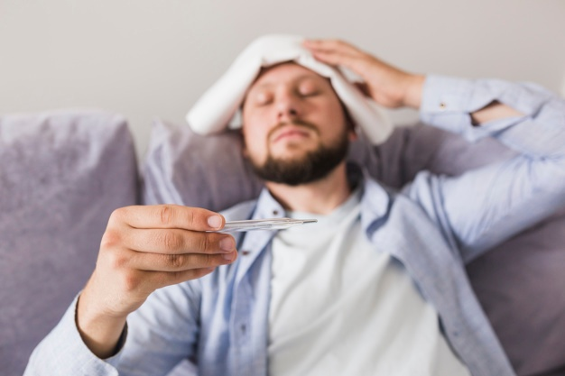
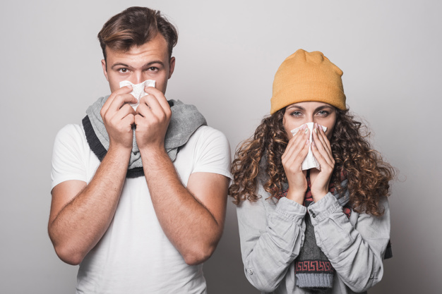
COVID-19, or Corona virus, is like the flu. It makes people get a fever, cough, and be very tired.

Slide 3
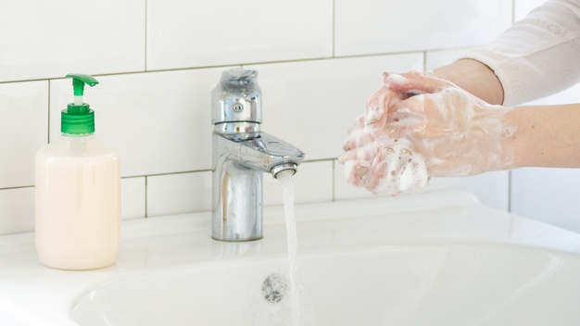
My family is doing everything they can to make us safe. We are staying at home and washing our hands. We are not inviting friends over.

Slide 4
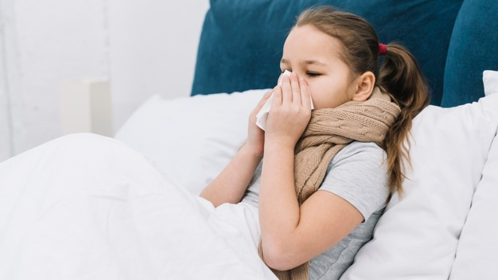

If I get sick, my grandpa will take care of me. He may have me take medicine. If I get really sick, he may take me to a doctor to help me get better.

Slide 5
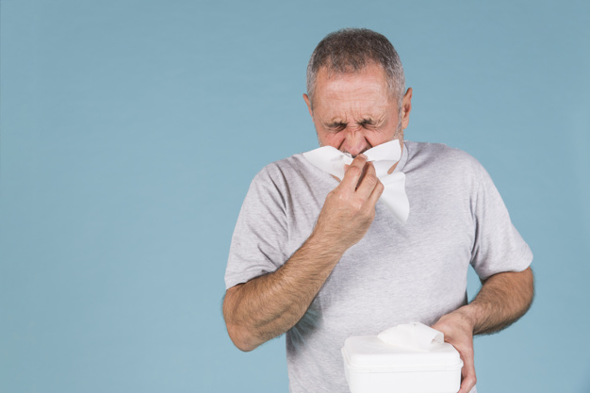
If grandpa gets sick, I need to make sure to listen to him. He may need my help to get things from the bathroom or kitchen. I can help grandpa, and that will make him happy.

Slide 6
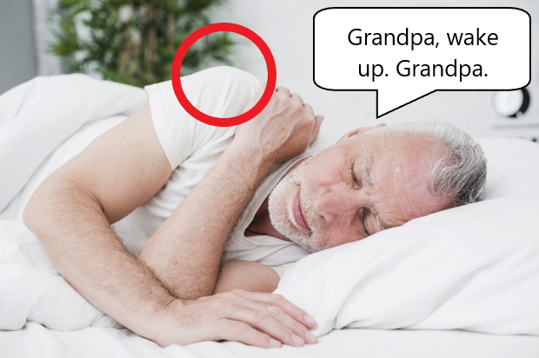
If grandpa is sleeping and I need something, I should wake him up. I should start trying to wake grandpa up by saying his name and tapping him on the shoulder.

Slide 7
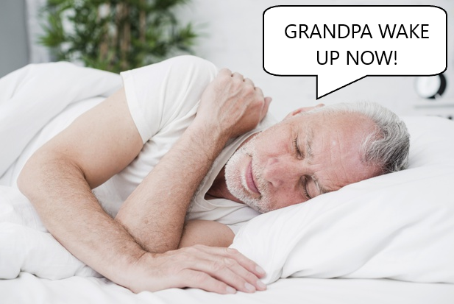
If grandpa does not wake up when I say his name and tap his on the shoulder, I should yell his name. It is ok to yell because grandpa may be very tired and not able to wake up.

Slide 8
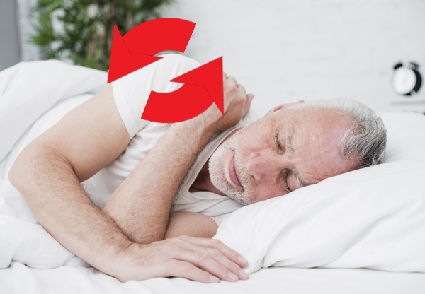
If grandpa does not wake up when I yell his name, I should grab his shoulder and shake it. It is ok to do this because grandpa is not waking up.

Slide 9
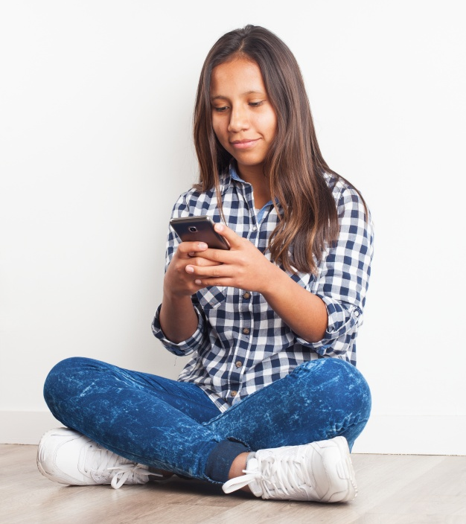
If grandpa does not wake up, that means it is an emergency. I need to call 911.

Slide 10

When I call 911, a person will answer the phone. They will say something like “911, what is your emergency?”

Slide 11
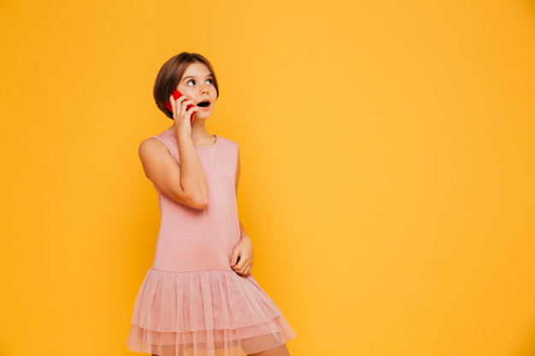
I should tell them my name, where I live, and that my grandpa will not wake up and needs help. I can read from my If I call 911 sheet.

Slide 12
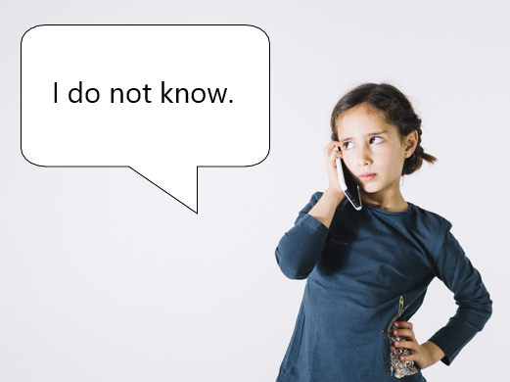
The person may ask me some other questions. I should answer as many of them as I can. If I don’t know an answer, that is ok. I should not get upset. If I do not know an answer I will say “I do not know.”

Slide 13
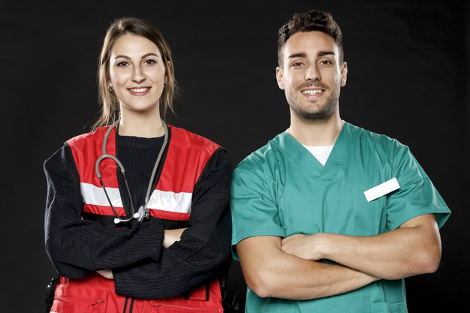
When the helpers arrive, they may ring the doorbell or knock on the door. I should ask who it is. They will say that they are here to help, or that they are paramedics or EMTs. I should open the door to let them in. I should then show them where grandpa is.

Slide 14
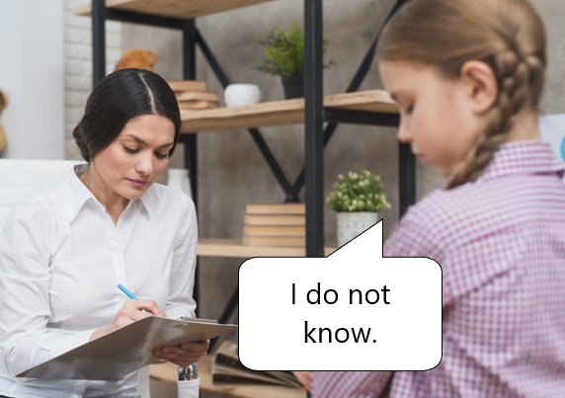
I should give the helpers space to work. I should not try to hug or touch grandpa while they are helping him. The helpers may ask me questions. I should answer as many of them as I can. If I don’t know an answer, that is ok. I should not get upset. If I do not know an answer I will say “I do not know.”

Slide 15
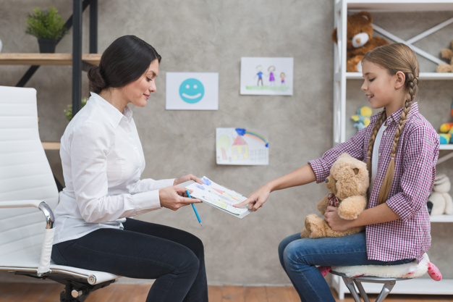
The helper may ask me if I have anyone to stay with. If they ask this I should show them My Emergency Information sheet. They can call the people grandpa wrote down and let them know what is going on.

Slide 16
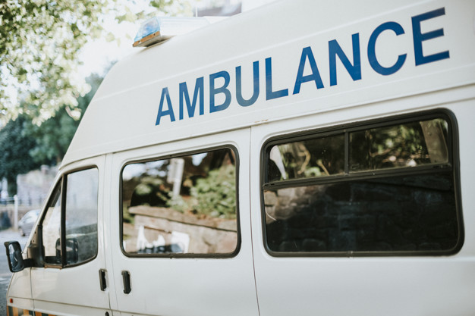
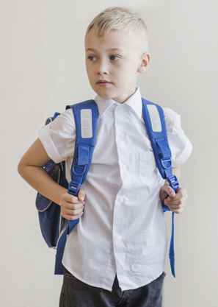
The helpers will need to take grandpa to a doctor. I may need to go with them. I should bring my Emergency bag and My Emergency Information sheet. If I need to go with them, I should be very calm. This will make the workers be able to take care of grandpa. I am being very brave.

Slide 17
The helpers will need to take grandpa to a doctor. I may need to go to someone else’s house. I should bring my Emergency bag and My Emergency Information sheet. If I need to go to someone else’s house, I should be very calm. This will make the workers be able to take care of grandpa. I am being very brave.

Slide 18
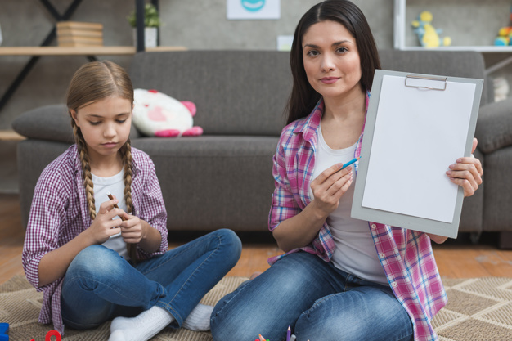
The helpers will need to take grandpa to a doctor. I may need to stay home. If I need to stay home, I should be very calm. This will make the workers be able to take care of grandpa. When another adult arrives, I should show them My Emergency Information sheet. I am being very brave.

Slide 19
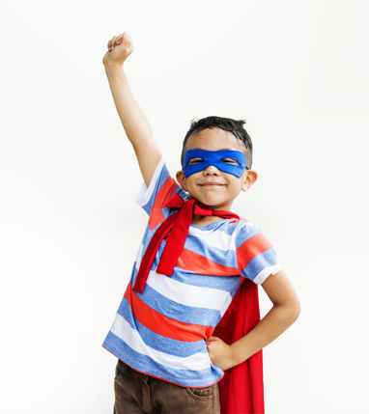
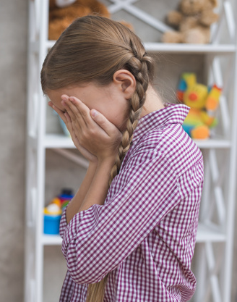
Grandpa being sick is scary. I may feel sad. It is ok to be sad. I should remember that grandpa would be very proud of me for being brave and getting his help.

